Slide 1
Adversarial Training for Relation Extraction
From EMNLP 2017
Yi Wu
Computer Science Division
UC Berkeley
David Bamman
School of Information
UC Berkeley
Stuart Russell
Computer Science Division
UC Berkeley

Slide 2
1.Abstract
Adversarial training is a mean of regularizing classification algorithms by generating adversarial noise to the training
data.
We apply adversarial training in relation extraction within the multi-instance multi-label learning framework.
Company Logo

Slide 3
2. Introduction
Adversarial training is a technique for regularizing deep models by encouraging the neural network to correctly classify both unmodified examples and perturbed ones, which in practice not only enhances the robustness of the neural network but also improves its generalizability.
Company Logo

Slide 4
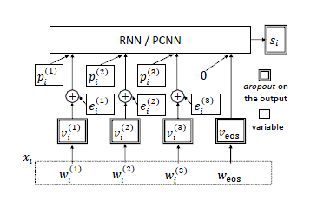
3. Methodology
We first introduce MIML and then describe the base neural network models we consider:1 piecewise CNN (Zeng et al., 2015) (PCNN) and bidirectional GRU (Cho et al., 2014) (RNN). We also utilize the selective attention mechanism in Lin et al. (2016) for both PCNN and RNN models. Adversarial training is presented at the end of this section.
Company Logo

Slide 5
3. Methodology
Input Representation and Sentence Encoder
PCNN [词向量+位置向量]
双向 GRU [词向量+指示向量]
位置向量=到两个距离向量的拼接
指示向量=该词是否为实体，是则为d维的向量1，不是则为0.
Company Logo

Slide 6
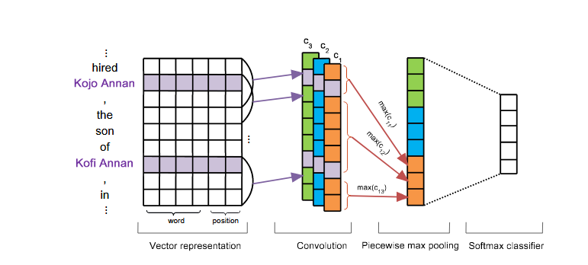
3. Methodology
Company Logo

Slide 7
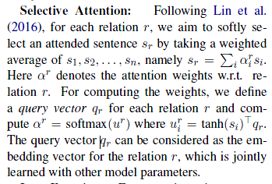
3. Methodology
Selective Attention
Company Logo

Slide 8
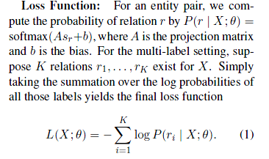
3. Methodology
Loss Function
Company Logo

Slide 9


3. Methodology
Adversarial Training
Company Logo

Slide 10

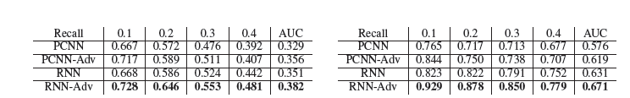
4. Experiments
数据集
Company Logo

Slide 11

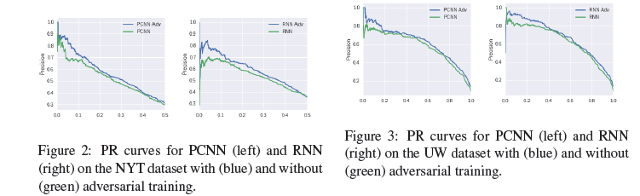
4. Experiments
Company Logo

